Slide 1


Lesson objective
While you wait – Solve:
$5x −9=10x −24$
$\frac{10x}{3}=24$
$$x=3.2$$
$$x=7.2$$
Title: Equations Review
Aim – be able to:
Identify equivalent equations
Verify the solution of an equation
Plan:
Equivalent equations
Substitute to prove
Need Whiteboards and calculators.

Slide 2
Choral response
The word is EQUIVALENT
Equations are equivalent if they have the same solution.
(the variable VALUE is the same)

Slide 3
Which is equivalent?
Which of the following is equivalent to x + 5 = 13
X + 1 = 9
4x + 2 = 42
4x + 1 = 33
10 – x = 2
4 + 3x = 16
X - 9 = 20
What should we do first?

Slide 4
Which is equivalent? TPS
Which of the below equations are equivalent to 2x + 4 = 10?
4x + 8 = 20
10 + 2x = 18
X + 2 = 5

Slide 5
Making equivalent equations
IF the equation is 2x + 4 = 10, we solved x = 3
Making an equivalent equation means we create our own equation BUT x MUST = 3
e.g.
3x + 5 = 14
20 – x = 17
100 + 3x = 109

Slide 6
Whiteboards – make your own
Make an equation where your x value is equal to:
X = 6
X = 10
X = 5

Slide 7
Timothy and Tina
Tim and Tina solved the equation: 4c + 11 = 23
Tim says c = 4
Tina says c = 3
How can we prove who is right and who is wrong?

Slide 8
Is the solution correct…..
To Verify a solution, we substitute a value and solve.
Is n = 5 a solution to….
N + 8 = 13
2n + 11 = 19
10 – 2n = 0
3n + 15 = 45 – 3n

Slide 9
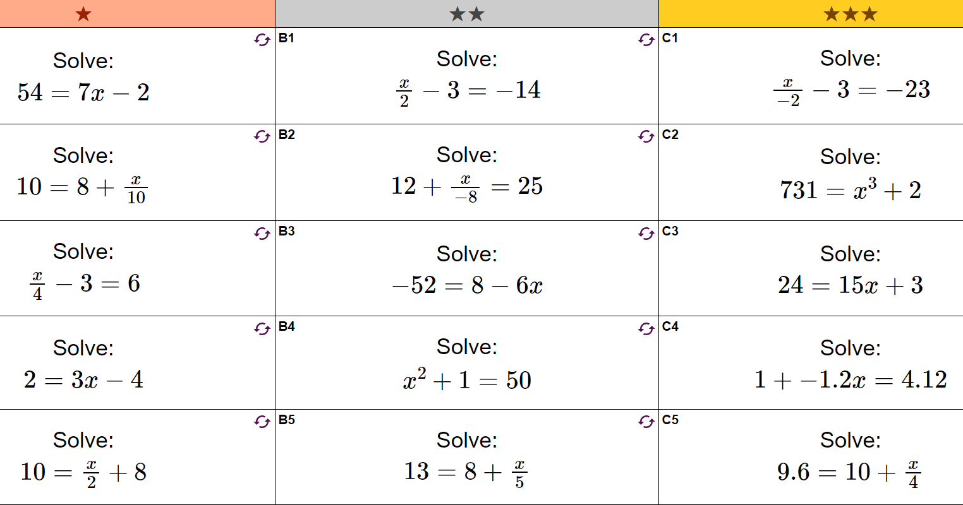

Slide 10
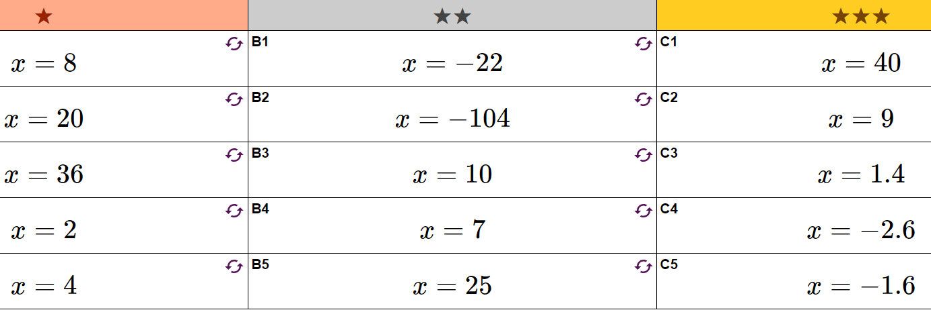

Slide 11
Equation solving practice
Famous Honolulu keyboarding school (year 8)
“did you hear about…” (year 8)

